Slide 1

AI-DRIVEN SMART PARKING MANAGEMENT
DEPARTMENT OF ARTIFICIAL INTELLIGENCE & MACHINE LEARNING
TEAM MEMBERS:
PROJECT GUIDE
MS. HARIPRABHA
SARAVANAN V(23619230) RAGUL S(23619247) MAHARAJA K(23619218)

Slide 2
Objectives
Project overview
The AI-Driven Smart Parking Management System integrates vehicle detection, number-plate recognition, parking reservations, slot allocation, anomaly monitoring, availability prediction, and duration-based billing.
Operational objectives
Support booked and walk-in vehicles.
Allocate available slots while preserving reserved spaces.
Manage vehicle entry, exit, parking sessions, and billing.
Provide parking information through user and administrator portals.
AI objectives
Use YOLO11n for vehicle detection.
Use EasyOCR for number-plate text recognition.
Apply a Random Forest model to predict parking availability for 30, 60, and 90 minutes.

Slide 3
Problem Statement & Proposed Solution
Parking access and allocation
Drivers may struggle to find available parking spaces. The system verifies bookings, preserves reserved slots, and assigns available slots to walk-in vehicles.
Monitoring and availability
Incorrect slot occupancy, double parking, and aisle obstruction can affect parking management. The prototype uses camera-based region analysis and rule-based checks to identify supported parking anomalies. A Random Forest model estimates future parking availability.
Integrated parking sessions
The FastAPI backend coordinates vehicle entry, slot assignment, parking-session records, exit processing, and billing. The user and admin portals provide access to the relevant parking information and management functions.

Slide 4
Base Paper & Literature Survey
Existing approach
Main focus
Limitation / scope
IoT-Based Smart ParkingSensors and ML for parking
Sensor deployment, scalability, data
quality and cost.
(2024)
ML-Based Availability Prediction (2024)
YOLO-Based Plate Recognition (2024)
AI-Powered Hybrid Parking (2025)
Proposed system
management and prediction.
Random Forest, SVM, KNN and Decision Focuses mainly on prediction rather than
complete session management.
Focuses mainly on recognition and
dashboard monitoring.
Focuses on optimization rather than the
complete entry-to-exit workflow.
Integrated parking-management workflow.
Tree forecasts.
Vehicle and plate detection with YOLO and CNN.
Allocation, demand prediction and parking recommendations.
ANPR, walk-in handling, allocation, anomaly detection, prediction and
Base paper: Henaien et al. (2024), TinyML Enabled Smart Parking. SSD MobileNet v2 FPNLite + EasyOCR with edge processing.

Slide 5
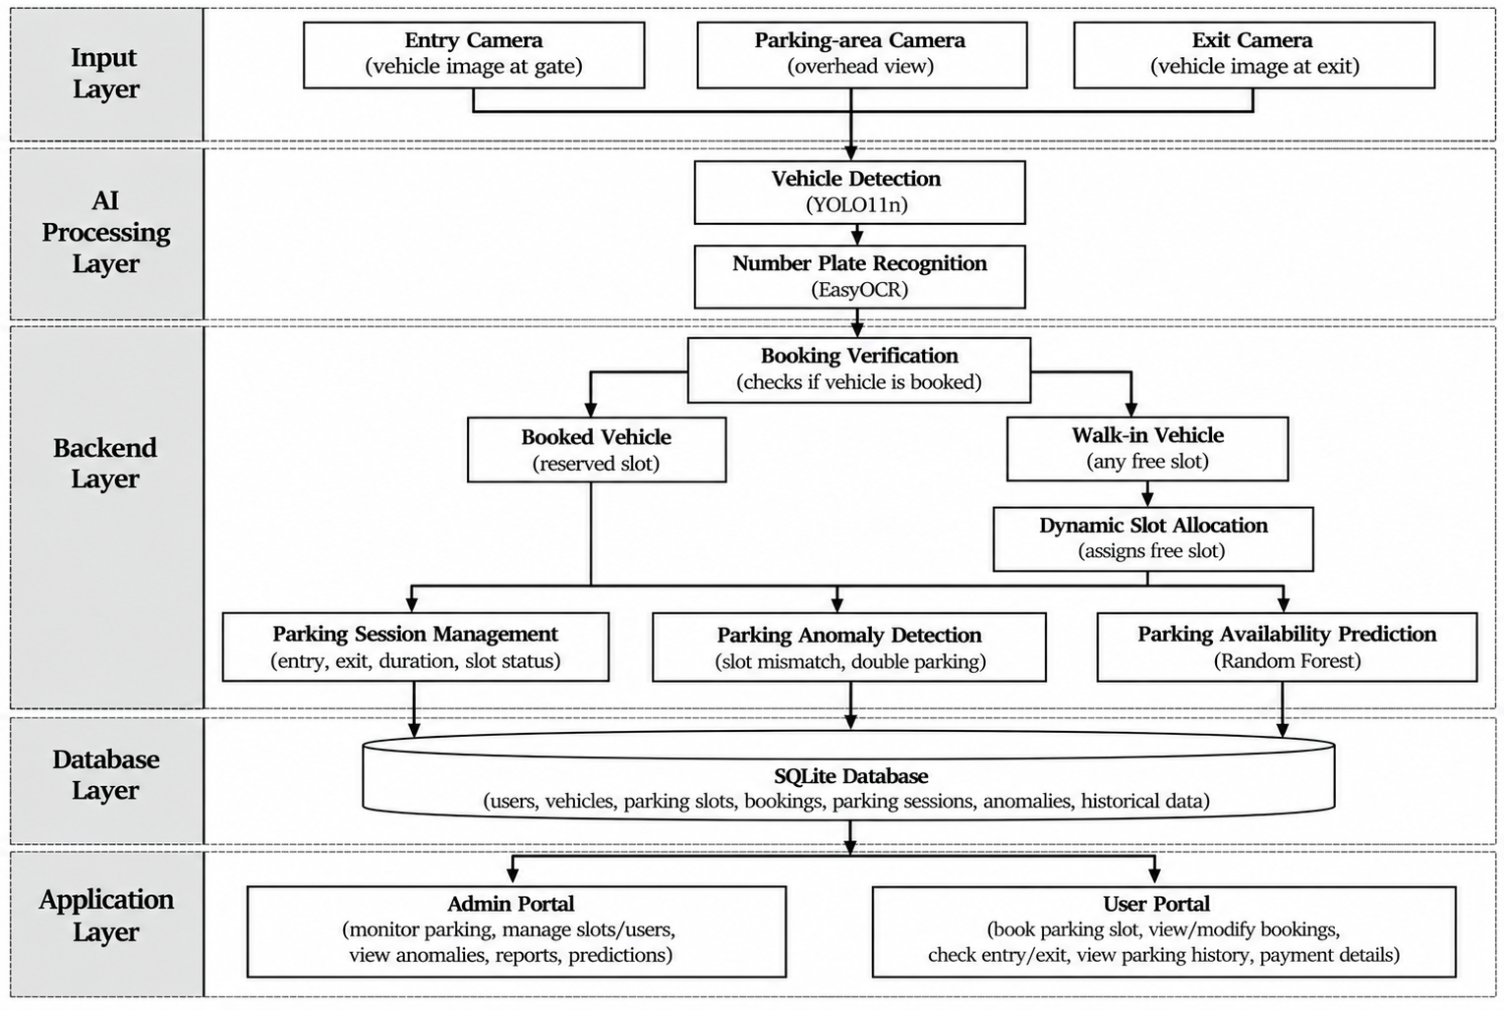
System Architecture

Slide 6
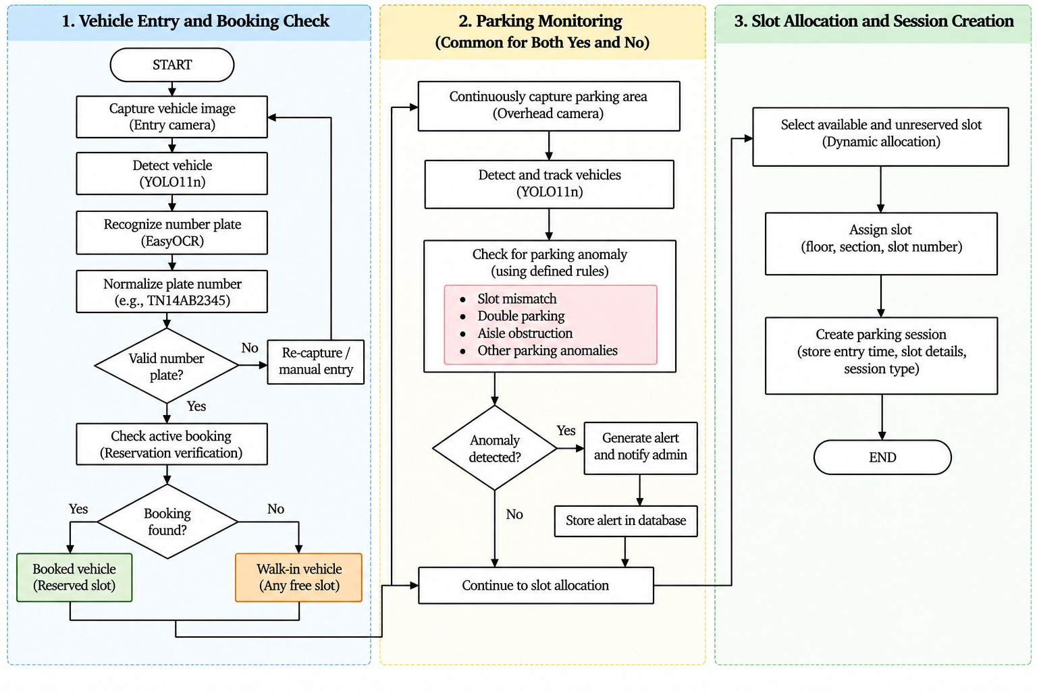
Flowchart

Slide 7
Module-wise Implementation Progress: Entry & Allocation
Module
Implementation described
Review 2 evidence / next check
Vehicle detection
YOLO11n + OpenCV identify incoming
vehicles.
Pipeline described. Validate detection on
recorded entry footage.
Plate recognition
ANPR + EasyOCR extract the vehicle
number.
Pipeline described. Record recognition
results under varied lighting.
Reservation & walk-in
Check the booking database and create
a parking session.
Workflow appears in the prototype. Check
booked and walk-in cases.
Slot allocation
Assign the booked slot or an available,
unreserved slot.
Allocation screen supplied. Verify
duplicate requests and full capacity.
Progress reflects the supplied deck and screenshots. Completion percentages are not available.

Slide 8
Module-wise Implementation Progress: Monitoring & Services
Module
Implementation described
Review 2 evidence / next check
Anomaly detection
Region analysis for wrong-slot, double parking and blocked aisles.
Design described. Capture a labelled anomaly demonstration.
Availability prediction
Random Forest outputs availability at 30, 60 and 90 minutes.
Prediction screen supplied. Evaluate against held-out parking records.
Billing
Compute parking duration and apply configurable charges.
Billing workflow described. Check rounding and payment records.
Database & portals
SQLite + FastAPI serve admin and user dashboards.
Dashboard screenshots supplied. Validate consistency after entry and exit.
Progress reflects the supplied deck and screenshots. Quantitative validation remains to be documented.

Slide 9
Software Requirements
AI and computer vision
Python 3.12, YOLO11n, ANPR, EasyOCR and OpenCV
Backend and prediction
FastAPI + Uvicorn, SQLite, scikit-learn and Random Forest Regression
Interface and development
HTML, CSS, JavaScript and VS Code. Planned hardware: ESP32-S3, ultrasonic sensors, RGB LEDs and an automatic barrier.

Slide 10
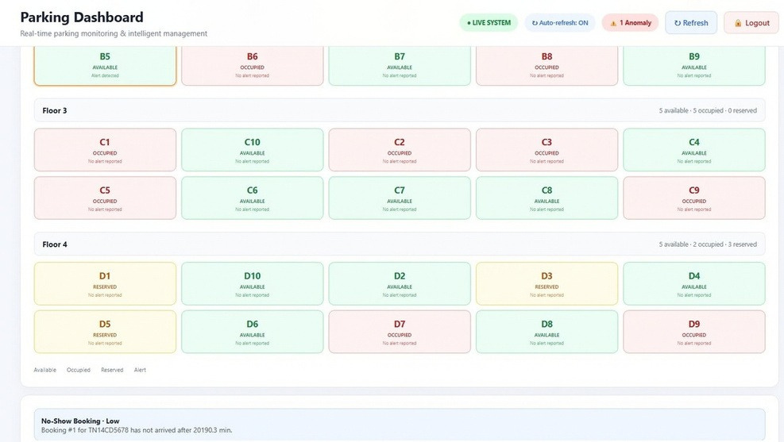
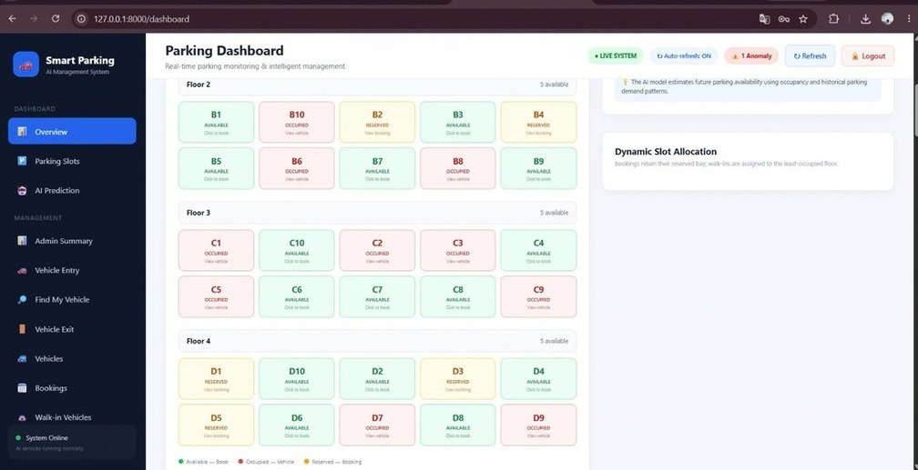
Prototype: Parking Dashboard
Provides real-time monitoring of 40 parking slots with available, occupied and reserved status.
Demo: open the dashboard and inspect available, occupied and reserved slots.

Slide 11
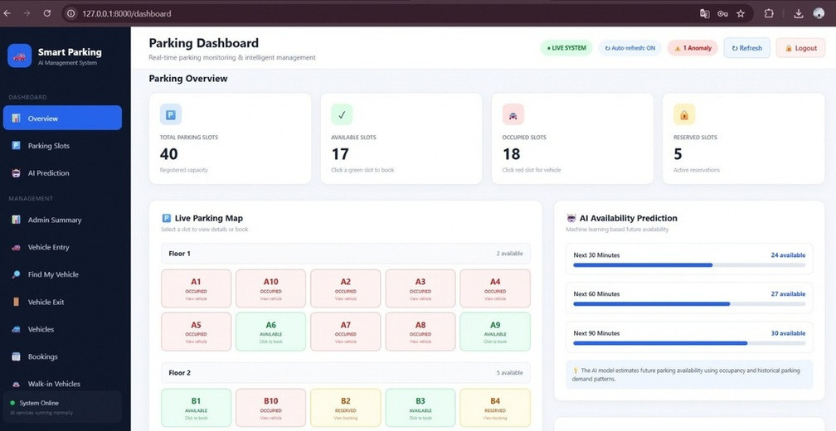
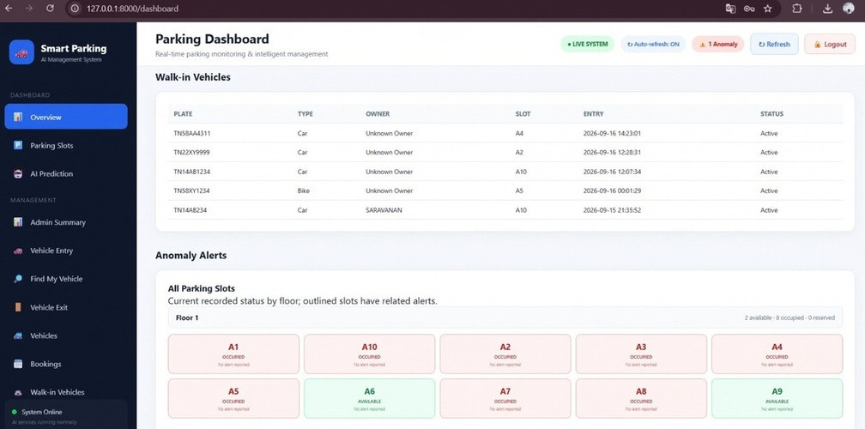
Prototype: Availability Prediction
Predicts future parking availability for the next 30, 60 and 90 minutes.
Demo: select a prediction horizon and compare the forecast with current availability.

Slide 12
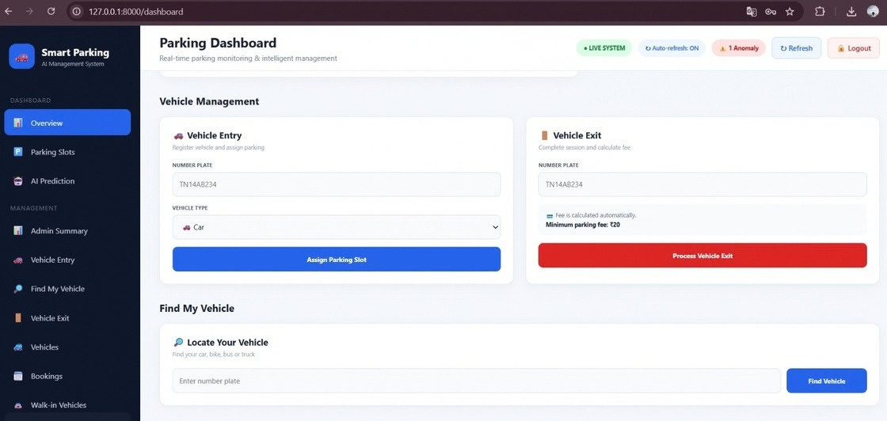
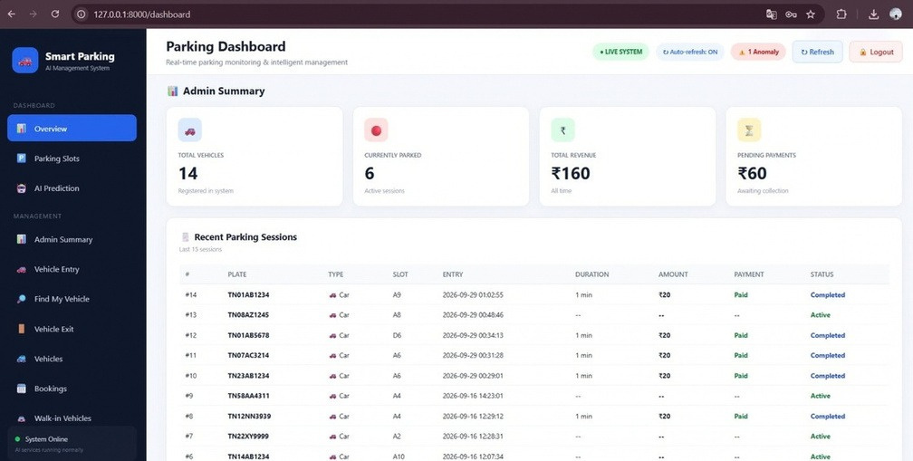
Working Demonstration: Entry & Slot Allocation
Dynamically assigns available slots while preserving reserved slots for booked vehicles.
Manages vehicle entry, slot assignment, exit processing and vehicle location lookup.

Slide 13
Testing Progress & Validation
Test area
Scenario and expected behaviour
Progress / evidence
Functional
Reserved vehicle gets its booked slot. Walk-in receives an eligible free slot.
Prototype screens supplied. Record repeatable test cases and outcomes.
Integration
Entry creates a session, updates the slot and makes the record visible in both portals.
Measure plate recognition success and availability prediction MAE on unseen data.
Full parking, duplicate booking, unreadable plate, invalid duration and exit processing.
Integrated workflow described. End-to- end execution log not supplied.
AI evaluation
Model choices supplied. Accuracy and MAE measurements not supplied.
Failure and boundary
Validation checklist proposed. Document actual results during the demo.
Review 2 status: prototype evidence available. Formal pass/fail counts and measured performance are pending documentation.

Slide 14
Challenges Faced & Mitigation Plan
Camera and recognition quality
Blur, tilted plates and poor lighting reduce recognition. Improve capture position, preprocessing and confidence handling before validating the plate.
Allocation and data consistency
Concurrent booking and entry can create slot conflicts. Use transactional checks and verify state updates across sessions, reservations and dashboards.
Prediction and real-time integration
Reliable forecasts require representative parking history. Collect data, evaluate held-out time periods and measure camera-to-dashboard update delay.

Slide 15
Journal / IEEE Conference Paper: Proposed TOC
Front matter and background
Abstract and Keywords; I. Introduction; II. Related Work; III. Problem Definition and Objectives
Design and implementation
IV. System Architecture; V. Methodology: YOLO11n, ANPR + EasyOCR, Slot Allocation, Anomaly Monitoring and Random Forest Prediction; VI. Implementation
Evaluation and conclusion
VII. Experimental Setup and Testing; VIII. Results and Discussion; IX. Limitations and Future Work; X. Conclusion; References
Proposed paper structure. Publication venue, submission and acceptance are not specified.

Slide 16
Results, Discussion & Future Work
Prototype evidence
The supplied screenshots show a 40-slot parking dashboard, prediction horizons of 30/60/90 minutes, slot assignment and vehicle-session management.
Evaluation still required
Document detection and plate recognition accuracy, prediction error, update latency and functional test outcomes before claiming measured performance.
Next phase
Integrate IoT occupancy sensing and barrier control, validate with real parking history, add online payment and test under varied camera and lighting conditions.

Slide 17
References
Henaien et al. (2024) – TinyML Enabled Smart Parking: Dynamic Slots Computing and License Plate Recognition. IEEE IWCMC.
Dahiya et al. (2024) – Machine Learning-Based Prediction of Parking Space Availability in IoT- Enabled Smart Parking Management Systems.
Safran et al. (2024) – Efficient Multistage License Plate Detection and Recognition Using YOLOv8 and CNN for Smart Parking Systems.
Smart Parking System Using YOLO, ANPR and MQTT with Artificial Intelligence Features (2025) – IEEE Conference Proceedings.
Murugan et al. (2025) – Smart Parking Innovations using Internet of Things, Computer Vision, and Artificial Intelligence – Recent Research Solutions. IEEE CCNCPS.
Smart Parking with Pixel-Wise ROI Selection using YOLOv8–YOLOv11 (2025/2026) – focuses on YOLO-based parking detection and ROI-based monitoring.

Slide 18
THANK YOU

